Slide 1
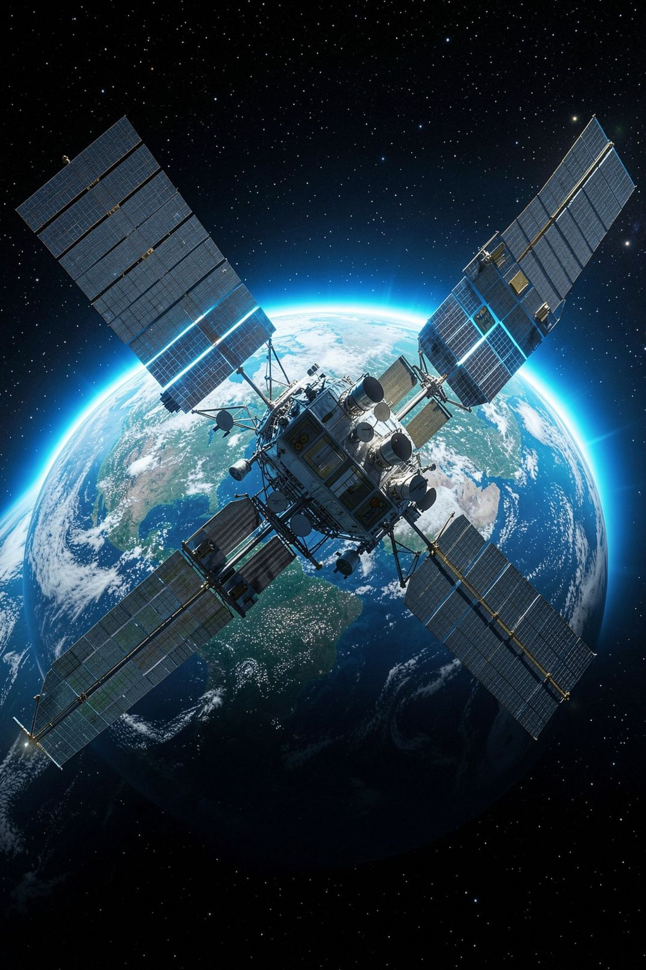
Embedded Intelligence in Modern Indigenous Spacecraft
Avionics, Edge AI, and Autonomous Systems
Presented By
Department of ECE
JAI KISHORE N S
KARTHIKEYAN S
SSM INSTITUTE OF ENGINEERING
AND TECHNOLOGY, DINDIGUL.

Slide 2
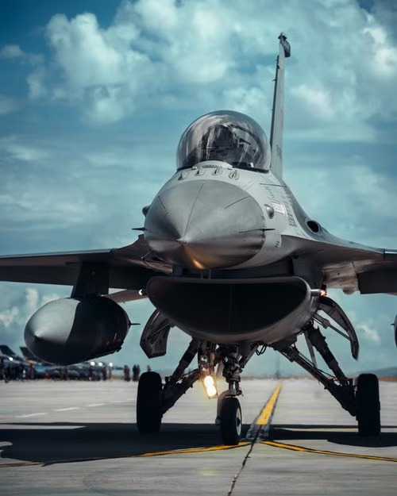
CHAPTER 1
The Shift to Autonomous Systems

Slide 3
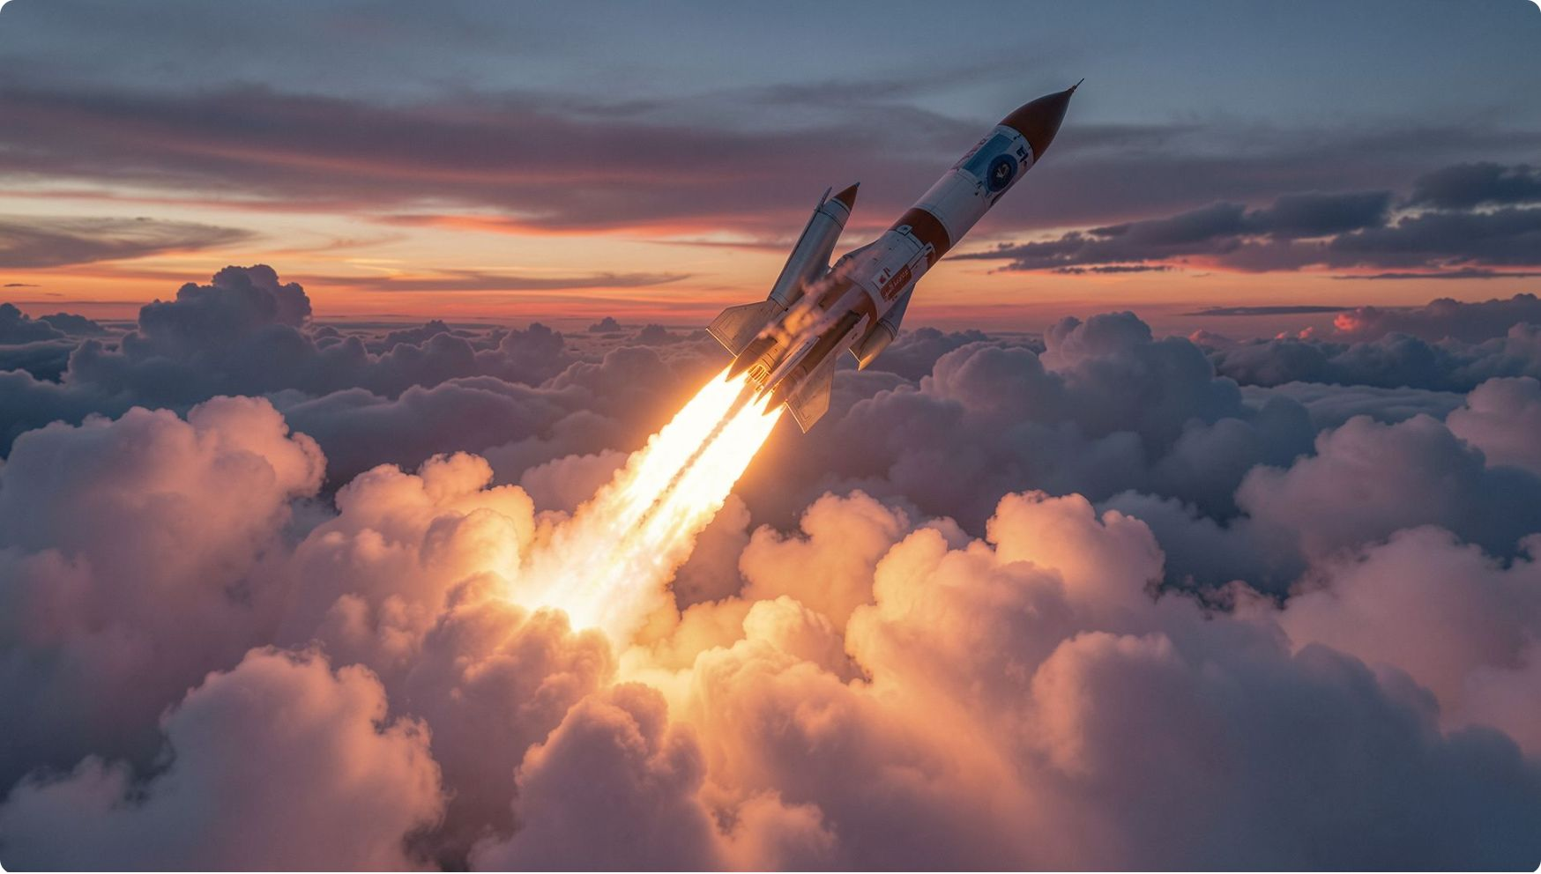
From Ground-Centric to Onboard Intelligence
Legacy Architecture
Traditional systems relied on Ground Telemetry, Tracking, and Command (TTC) stations for all flight path processing — a fundamental bottleneck.
The Latency Problem
Hypersonic ascent, orbital rendezvous, and re-entry demand microsecond-scale response times that ground loops simply cannot provide.
Embedded Intelligence
Radiation-tolerant microcontrollers, FPGAs, and hard real-time operating systems (RTOS) now handle local intelligence onboard.

Slide 4
Real-Time Guidance, Navigation, and Control (GNC)
Multi-Sensor Fusion
Deterministic Processing
Closed-Loop Control
NavIC & GPS integration delivers precise position and velocity vectors. Ring Laser Gyros and Fiber Optic Gyros track angular rates with exceptional fidelity.
Extended Kalman Filters isolate structural vibration noise from rigid-body dynamics at 100+ Hz refresh rates, ensuring clean state estimation.
LQR and adaptive PID algorithms continuously adjust Thrust Vector Control actuators in real time, maintaining precise attitude authority.

Slide 5
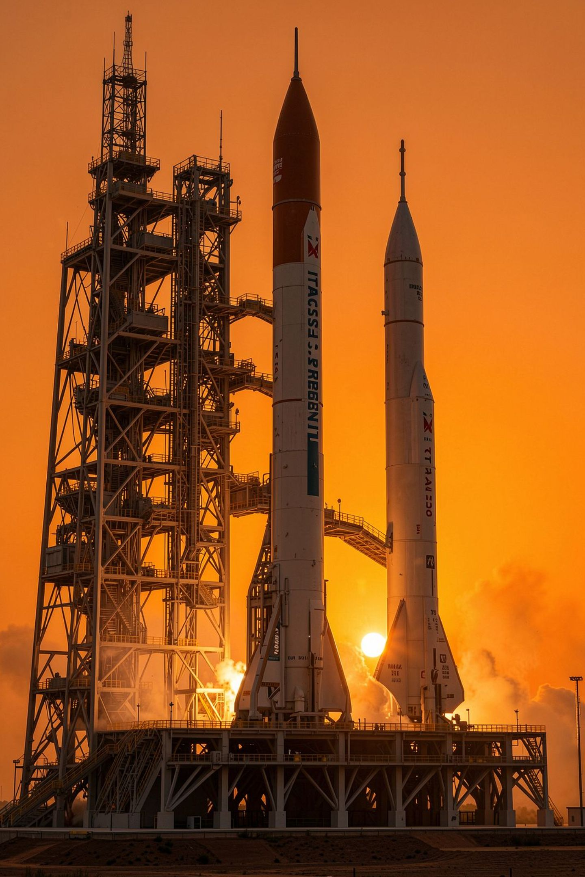
CHAPTER 2
Indigenous Case Studies

Slide 6

ISRO's SPADEX: Autonomous Docking
Mission Overview
SPADEX (Space Docking Experiment) demonstrates real-time autonomous docking between two small satellites — a Chaser and a Target — without any ground intervention during the critical rendezvous phase.
Key Technical Achievements
Autonomous optical rendezvous algorithms run directly on embedded vision processing boards
Relative Navigation fuses LIDAR, relative GPS, and star tracker data
Achieves millimeter-per-second precision entirely onboard

Slide 7




Pushpak (RLV-TD): Autonomous Landing
Terminal Approach
Onboard flight control autonomously initiates the final approach sequence with no ground command loop.
Crosswind & Glide-Path Correction
Flight computers calculate complex crosswind corrections and glide-path trajectory adjustments in real time.
Speed Transition & Brake Deployment
Edge control manages the critical supersonic-to-subsonic transition, triggering brake deployment at precise thresholds.

Slide 8
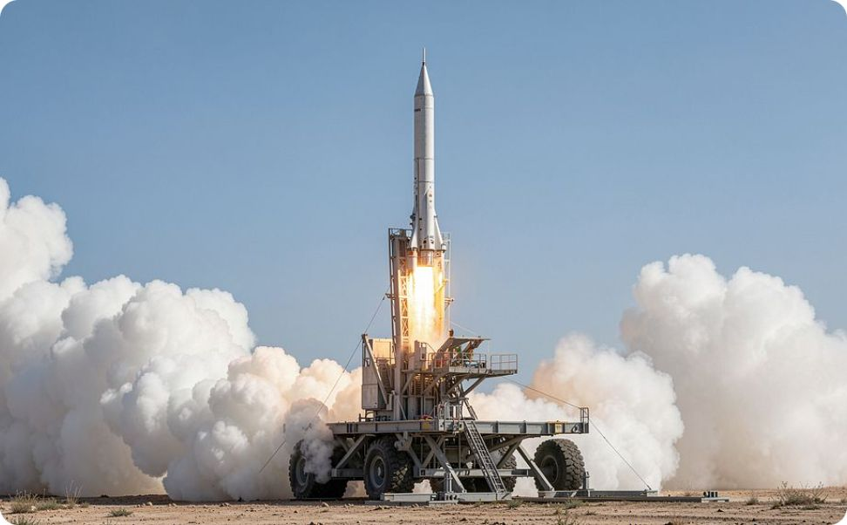
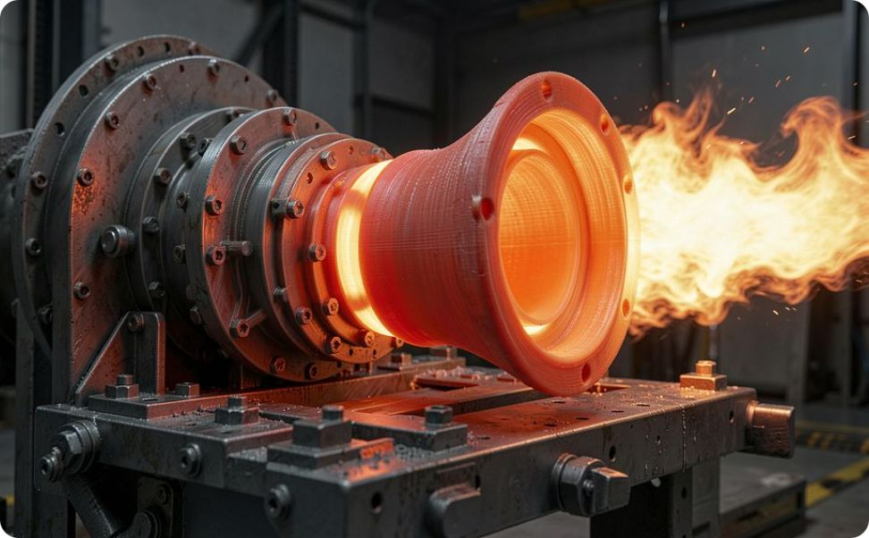
Private Sector Innovation
Skyroot Aerospace — Vikram-S & Vikram-1
Agnikul Cosmos — Agnibaan SORTED
Custom compact avionics built on multi-node microcontroller boards with distributed sensor processing — bringing launch vehicle intelligence to a new scale of miniaturization.
Modular autopilot system controlling electric pump-fed engines and thrust-vector actuators in real time — the world's first flight of a fully 3D-printed engine guided by embedded autonomy.

Slide 9
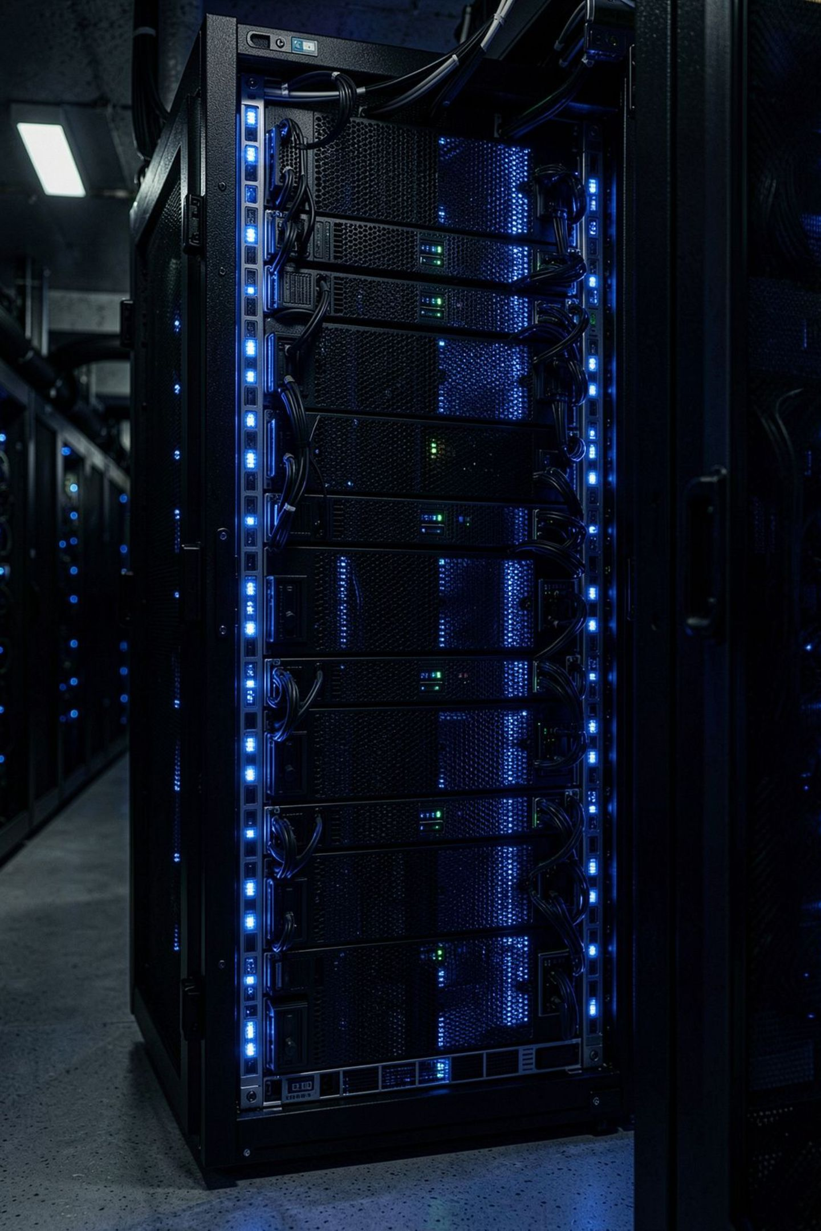
CHAPTER 3
Edge AI and Orbital Computing

Slide 10
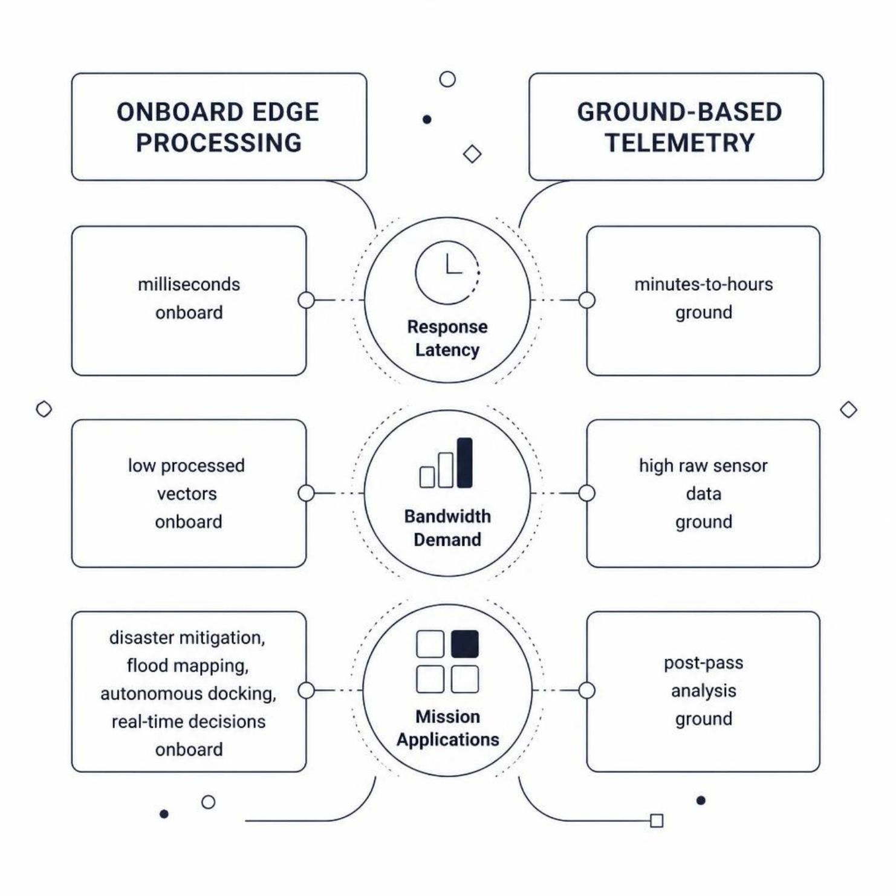

Onboard Processing vs. Traditional Telemetry
Why Onboard Wins
The fundamental constraint of ground-based telemetry is the speed of light combined with orbital geometry. A satellite in low Earth orbit may be in contact with a given ground station for only 8–12 minutes per pass.
Edge AI eliminates this dependency entirely. Processed intelligence — not raw sensor streams — is transmitted, slashing bandwidth requirements while enabling truly autonomous operations across the entire orbit.
Real-time disaster mitigation and rapid flood mapping are only possible when the spacecraft itself decides — not the ground.

Slide 11
Radiation Hardening and Fault Tolerance
1
2
3
Triple Modular Redundancy (TMR)
Watchdog Failover
Flash-Based FPGA Reconfiguration
When Single Event Upsets (SEUs) are detected, millisecond-level switching transfers control to a redundant hot-backup controller — transparent to the mission timeline.
Three identical processor cores run in parallel. A majority voter circuit arbitrates the consensus output — a single bit-flip from cosmic radiation is silently corrected before it can propagate.
In-orbit firmware updates allow engineers to reroute logic around damaged gate arrays discovered post-launch — turning hardware faults into a software problem.

Slide 12
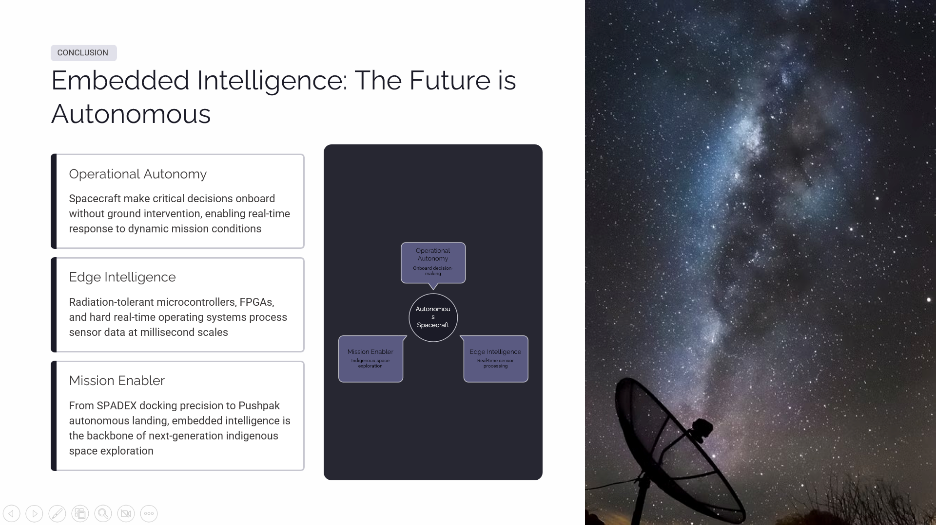

Slide 13


